Slide 1
MongoDB CRUD operations/neo4j Modifying

Slide 2
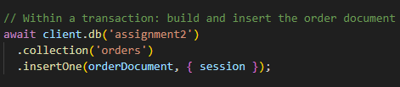
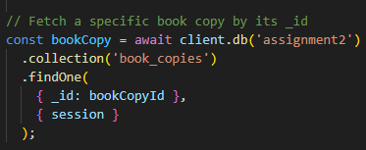
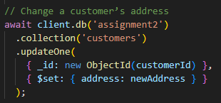
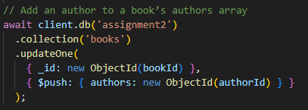
MongoDB CRUD Operations
Create
Read
Update

Slide 3
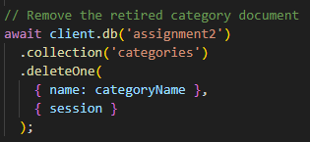
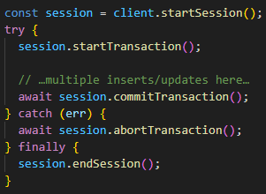
MongoDB CRUD Operations
Delete
Transactions

Slide 4
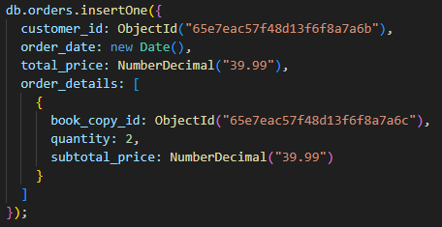
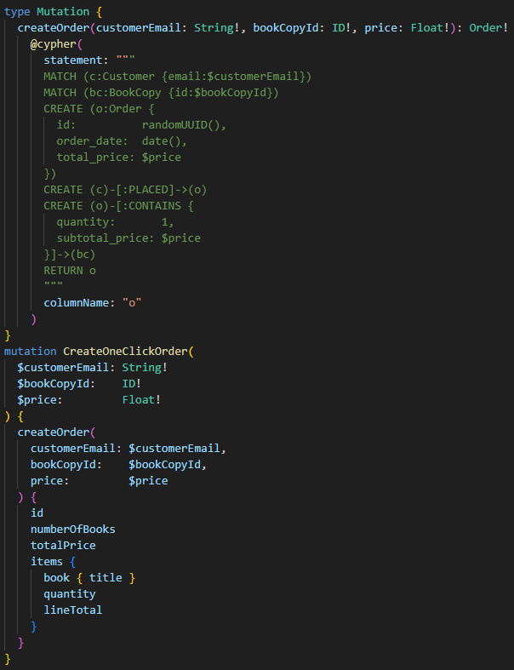
Comparing Data Modification Document vs. Graph
Insert

Slide 5
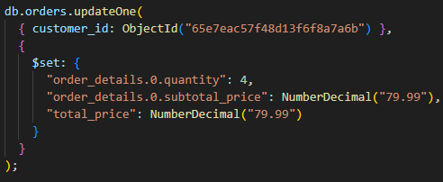
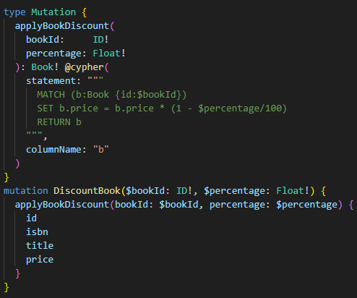
Comparing Data Modification Document vs. Graph
Update

Slide 6
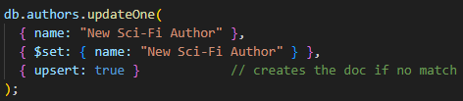
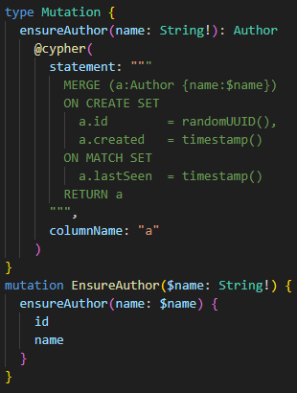
Comparing Data Modification Document vs. Graph
Upsert

Slide 7
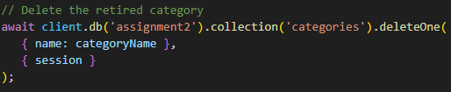
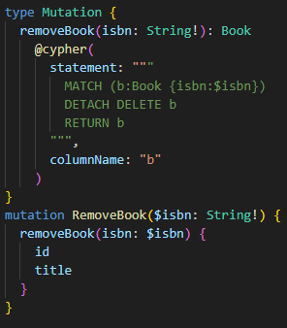
Comparing Data Modification Document vs. Graph
Delete

Slide 8
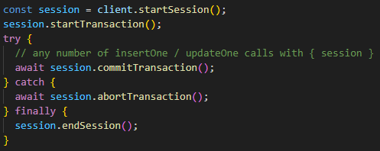
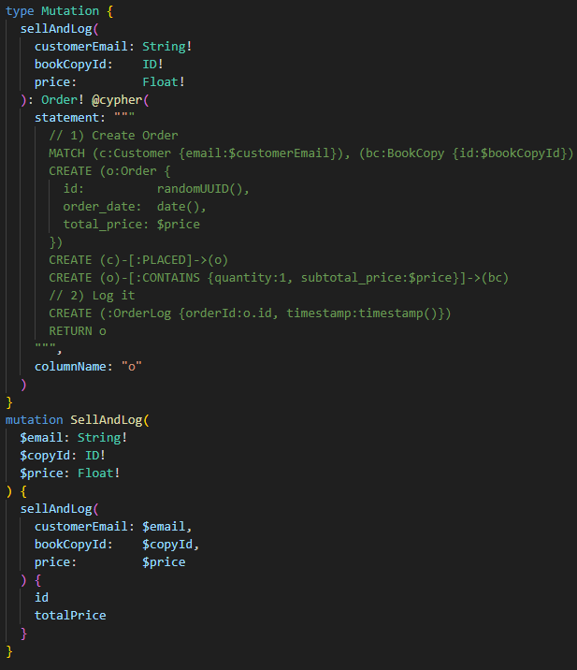
Comparing Data Modification Document vs. Graph
Transactions

Slide 9
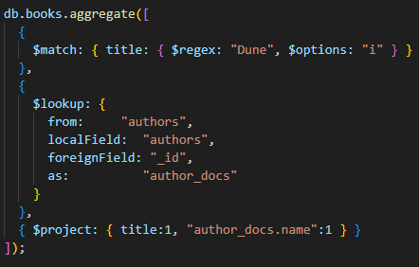
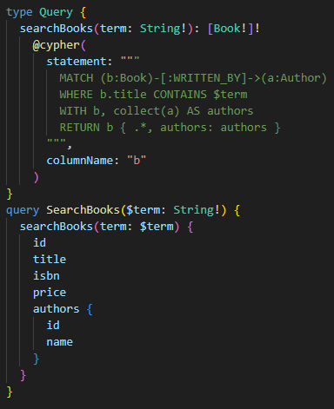
Comparing Data Modification Document vs. Graph
Fetch related data: Separate vs. Pattern

Slide 10
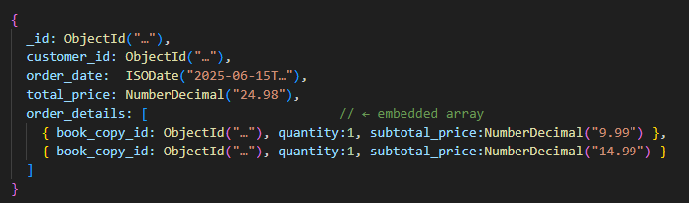
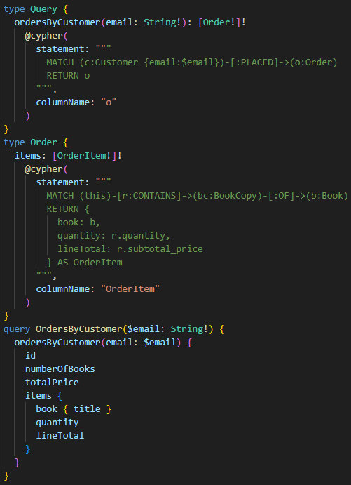
Comparing Data Modification Document vs. Graph
Embedded vs. Separate

Slide 11
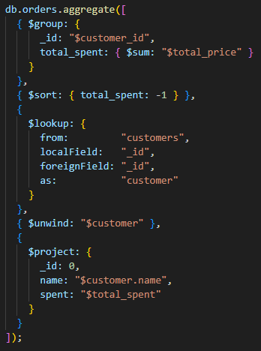
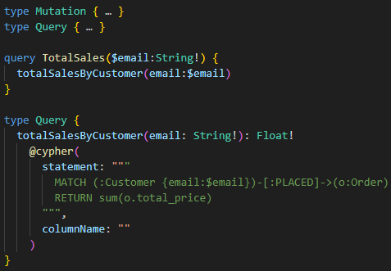
Comparing Data Modification Document vs. Graph
Declarative DSL

